Slide 1

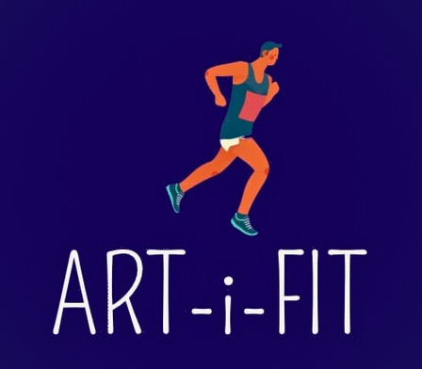
ART-i-FIT

Slide 2
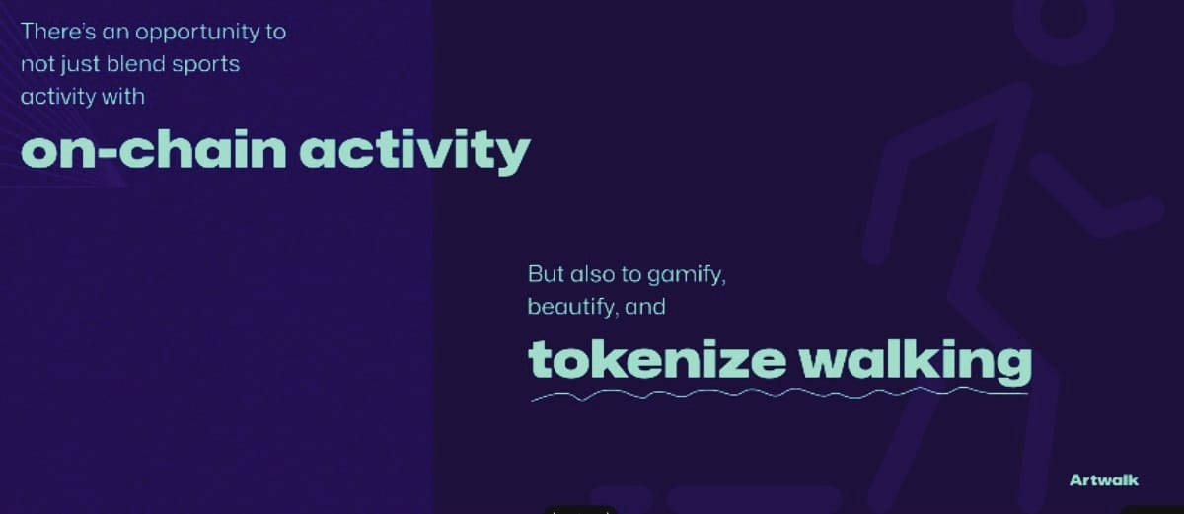

Slide 3

Problem Statement:
The challenge at hand pertains to motivating today's youth, who predominantly immerse themselves in indoor activities such as extended social media usage and immersive video gaming, to re-engage with outdoor physical activities. The goal is to transform the daunting prospect of a 30-minute daily walk into a compelling and enjoyable endeavor. The traditional fitness and sports apps do provide a solution but often at the expense of users' data privacy and security. The endeavor is to create an innovative mobile DApp that gamifies and tokenizes outdoor activities, making them both creative and rewarding, while simultaneously protecting user data. This solution is anticipated to bridge the gap between the virtual and physical worlds in a manner that engages young individuals and encourages them to embrace outdoor activities once again, this time under the alluring umbrella of blockchain-driven incentives and data security.

Slide 4

Solution:
Walk, Create, and Earn: ArtWalk,
Where Art Meets Blockchain...
Bringing the Joy Back to Outdoor Adventures, One Step at a Time
Firstly, Get Started!!

Slide 5
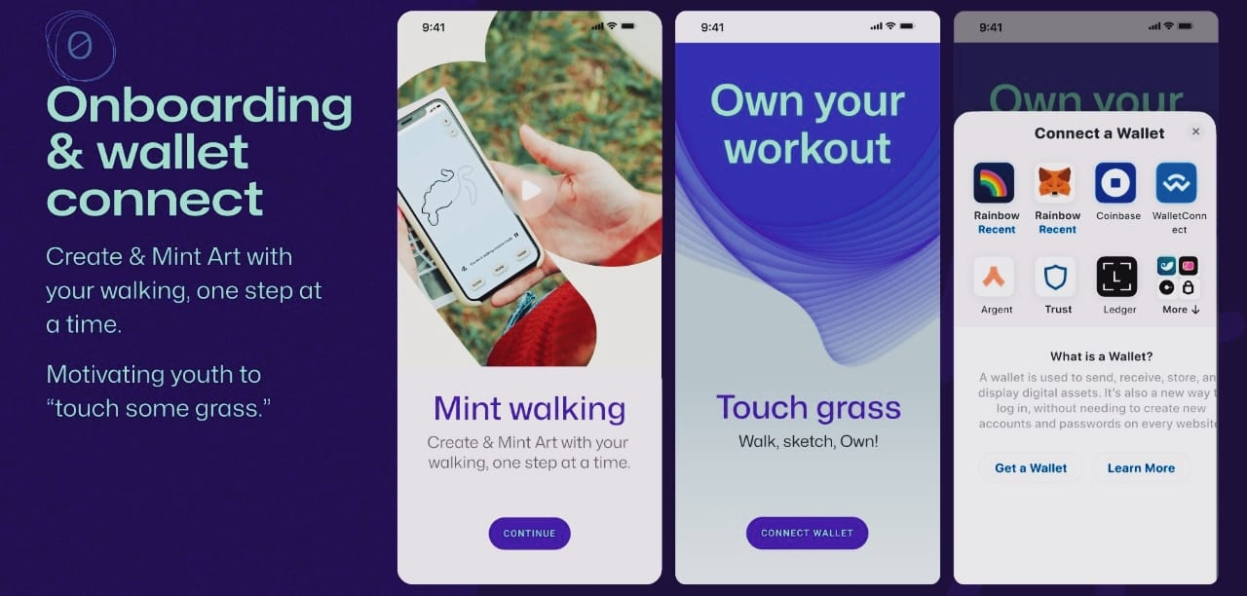
Our Product:

Slide 6
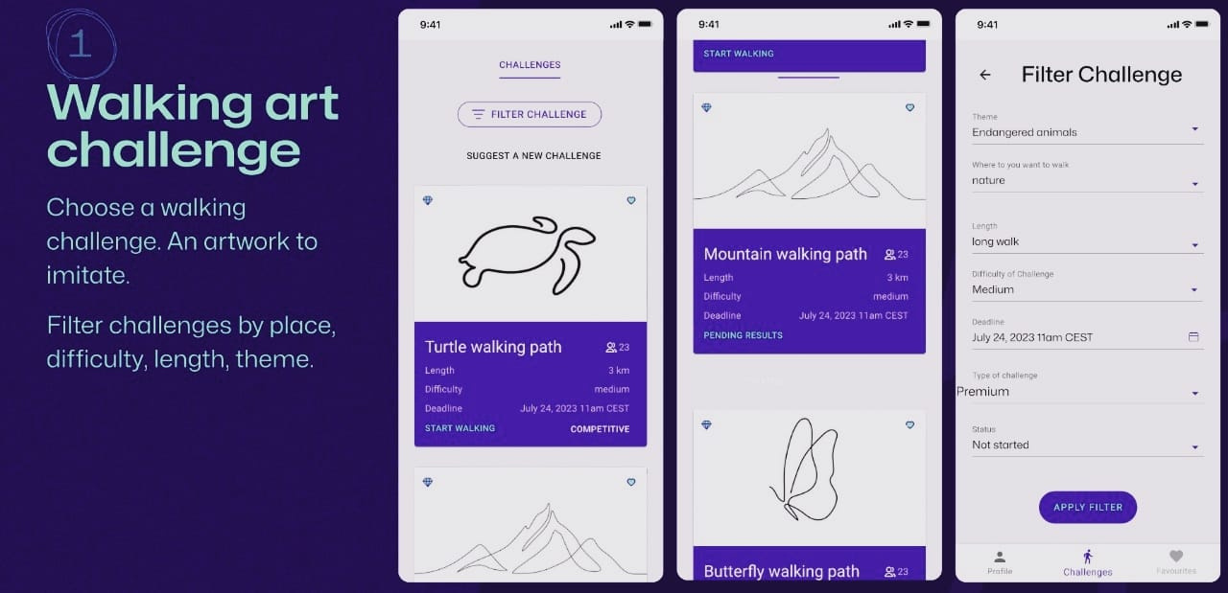

Slide 7
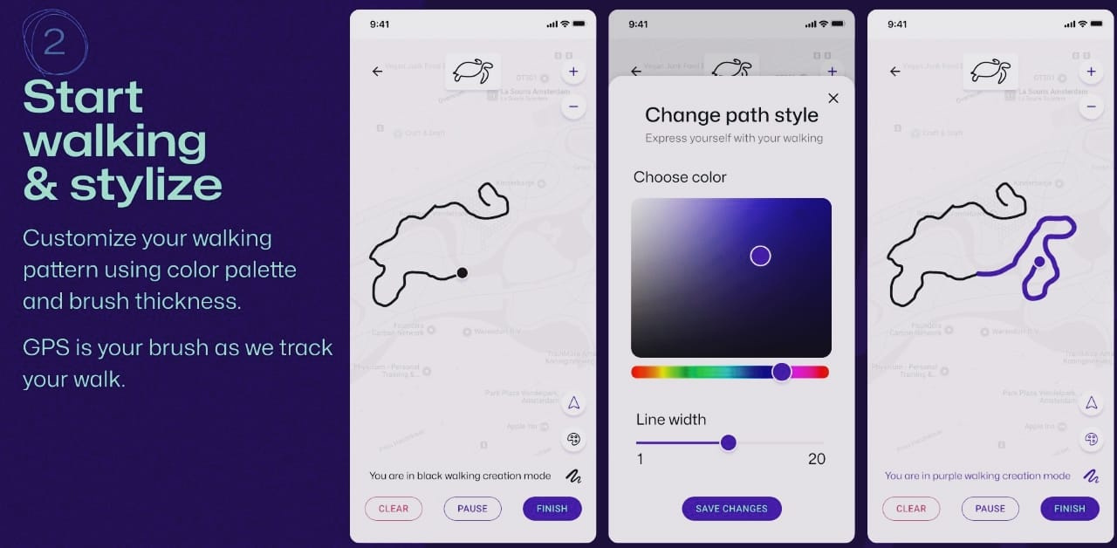

Slide 8
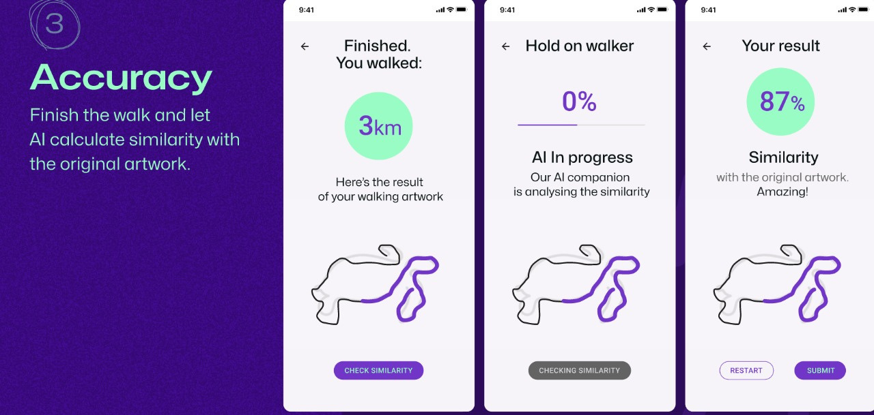

Slide 9
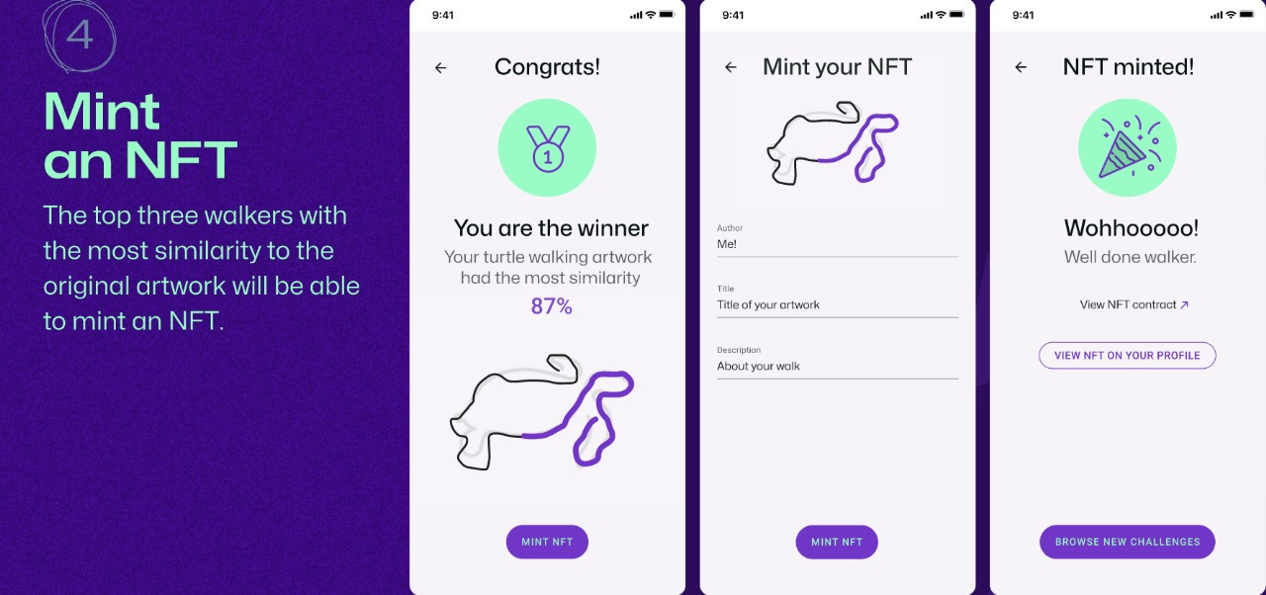

Slide 10
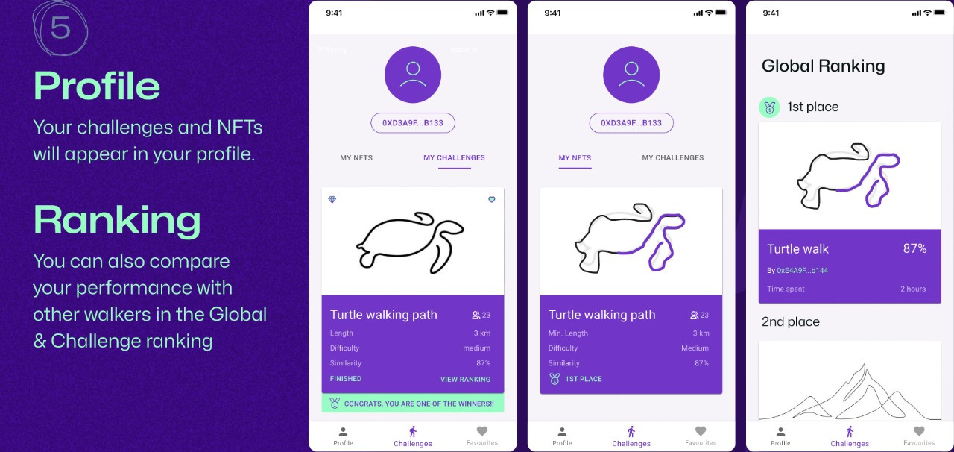

Slide 11
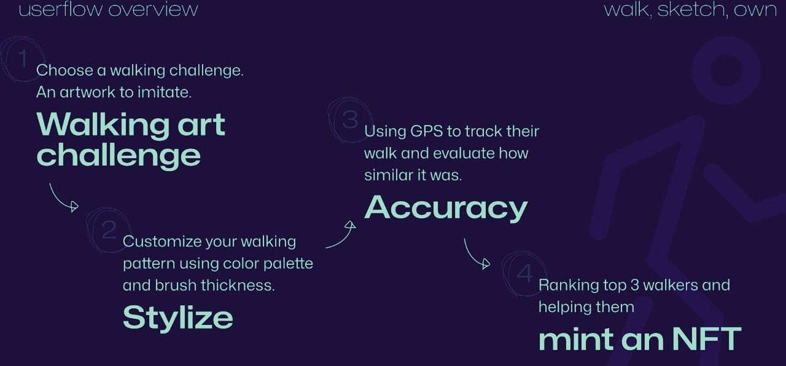

Slide 12
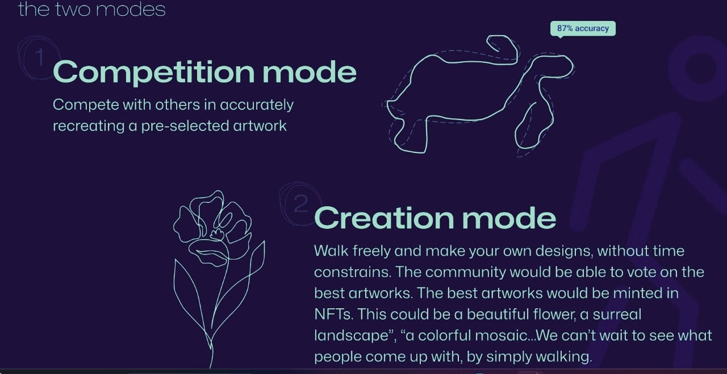

Slide 13
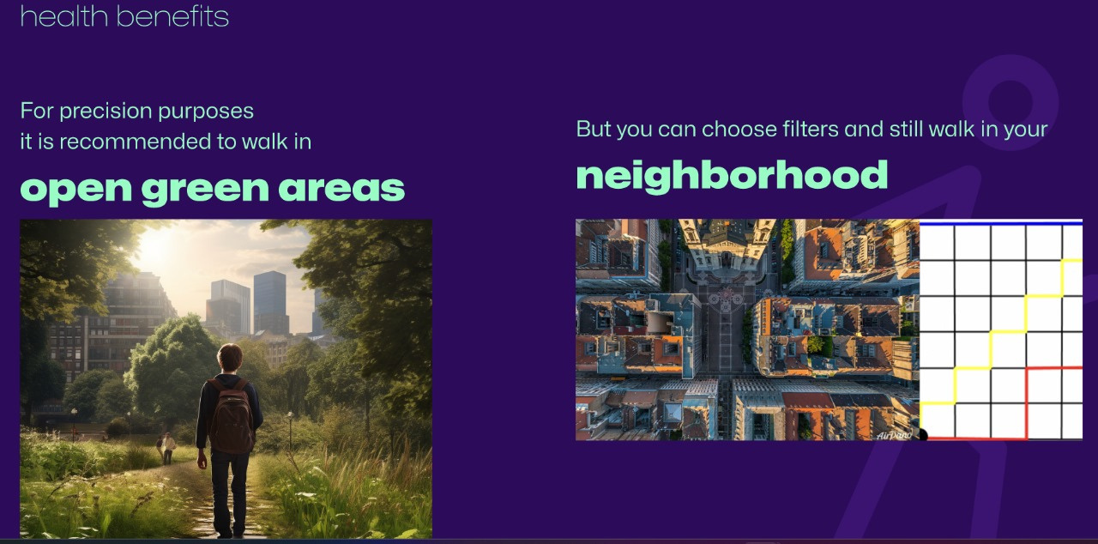

Slide 14
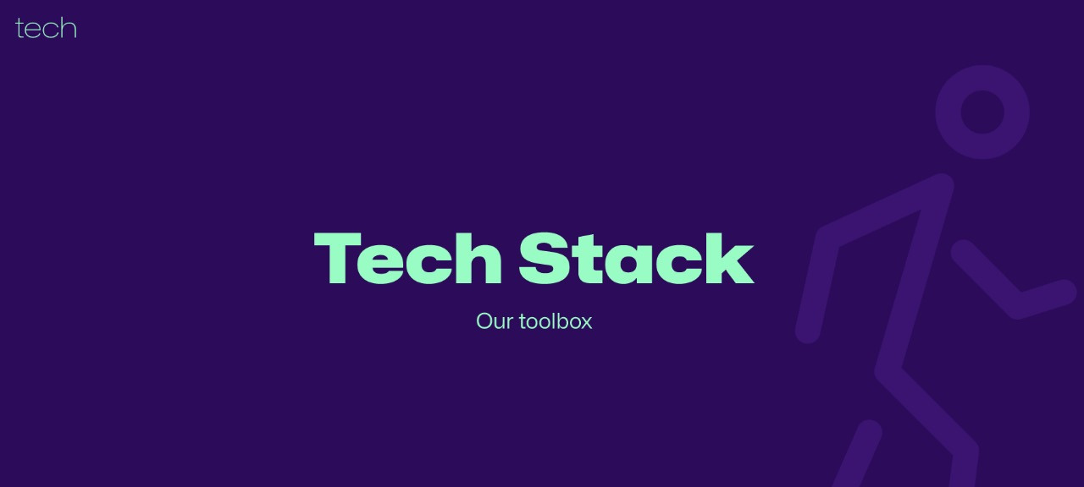

Slide 15
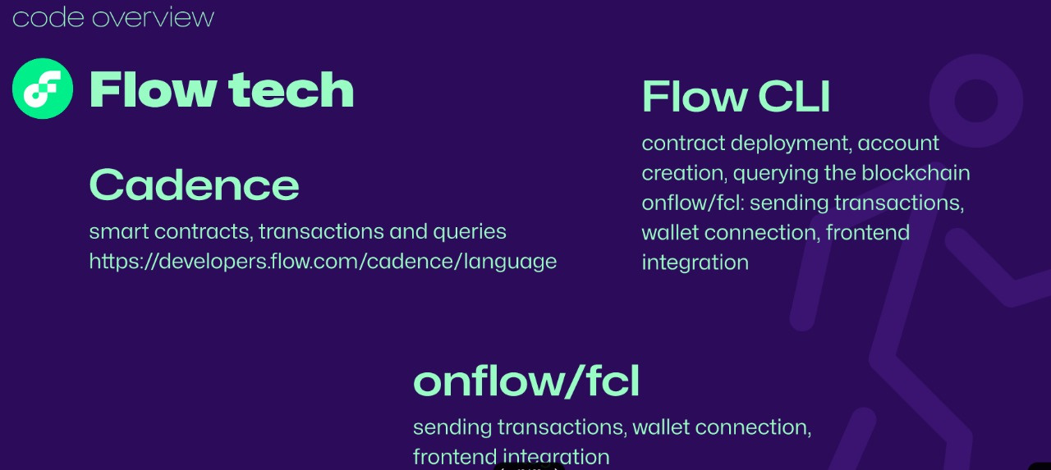

Slide 16
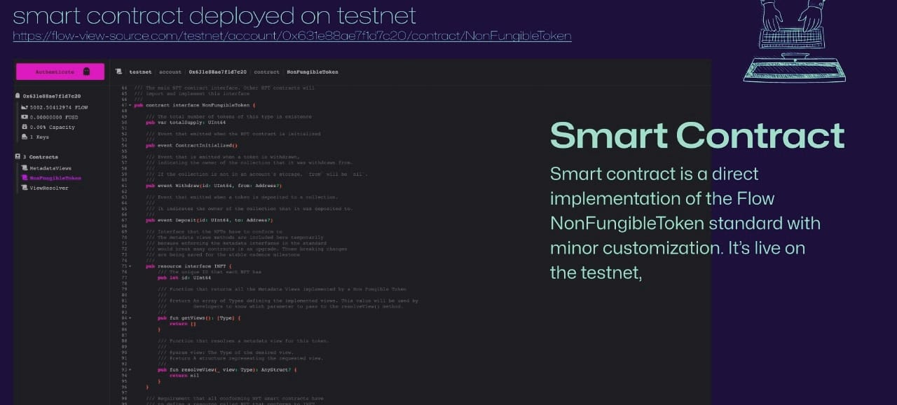

Slide 17
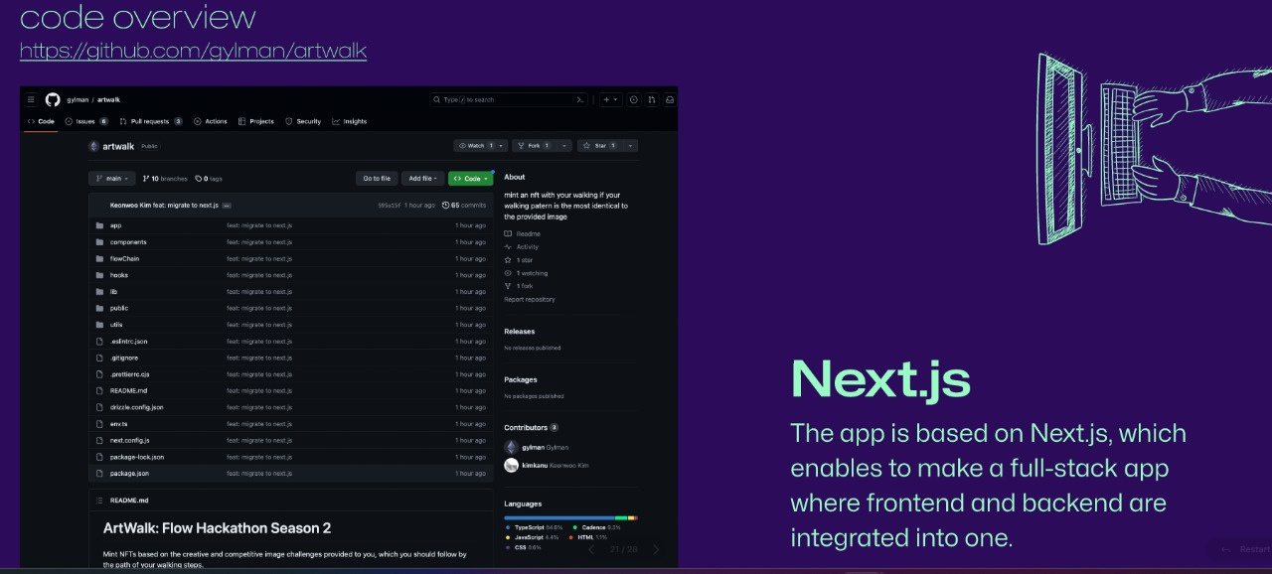
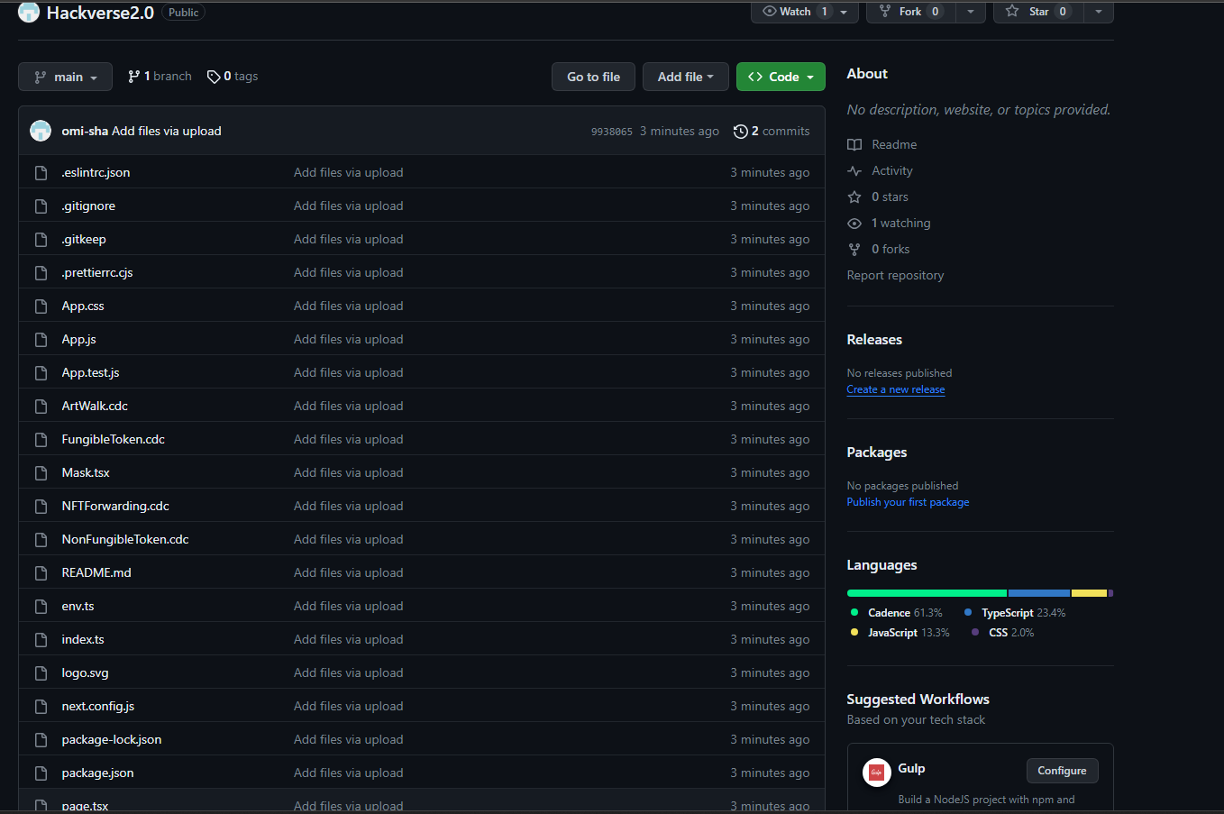
https://github.com/omi-sha/Hackverse2.0

Slide 18
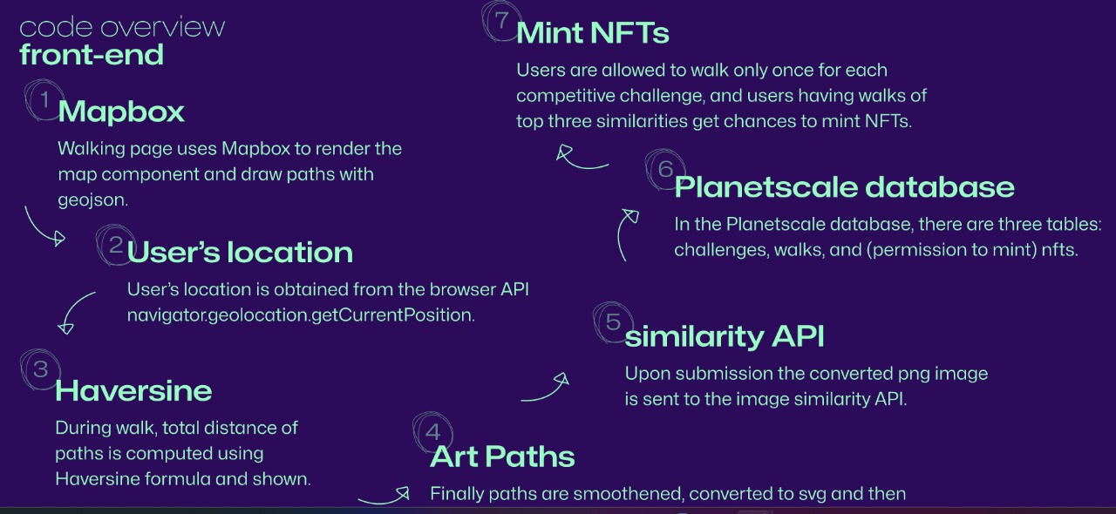

Slide 19
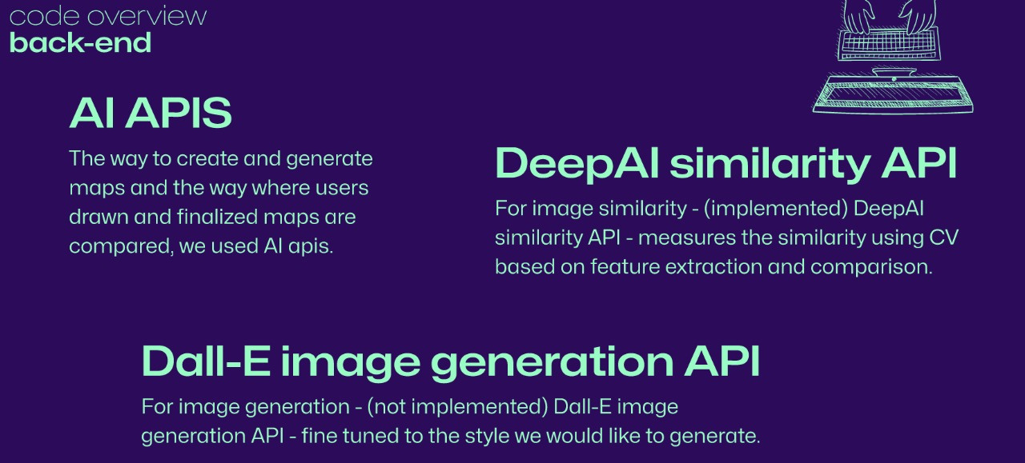

Slide 20
The Role of Wanchain
Wanchain is one such platform created with an aim to connect isolated public and private blockchains allowing for cross-chain transactions and enabling a clear flow of digital assets and data.The cross-chain message passing SDK provided by Wanchain allows developers to communicate and transfer data between these chains.
We chose Wanchain because it offers advanced cross-chain capabilities, ensuring smooth interactions between multiple blockchains. Its security, scalability, and developer-friendly tools make it the ideal choice for my project, which aims to facilitate cross-chain transactions and data recording across different blockchain networks.
We are using Wanchain's cross-chain message passing SDK to seamlessly connect our decentralized application with the Wanchain L1 blockchain and other EVM-compatible blockchains, enabling secure and efficient data transfer and transactions across multiple networks.

Slide 21
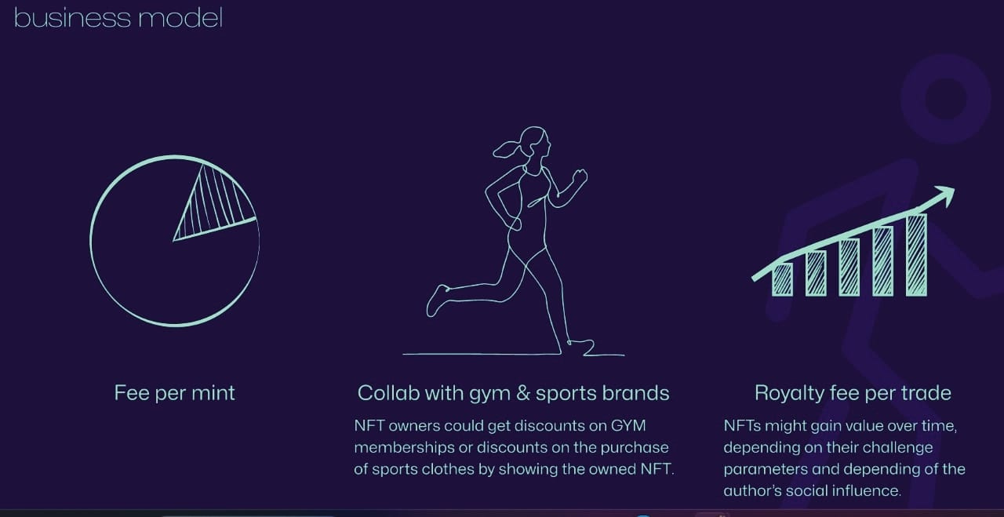

Slide 22
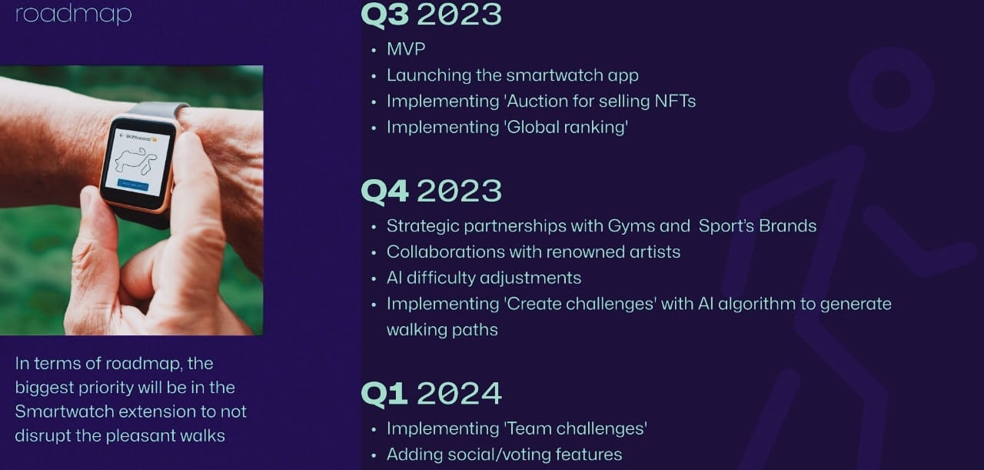

Slide 23
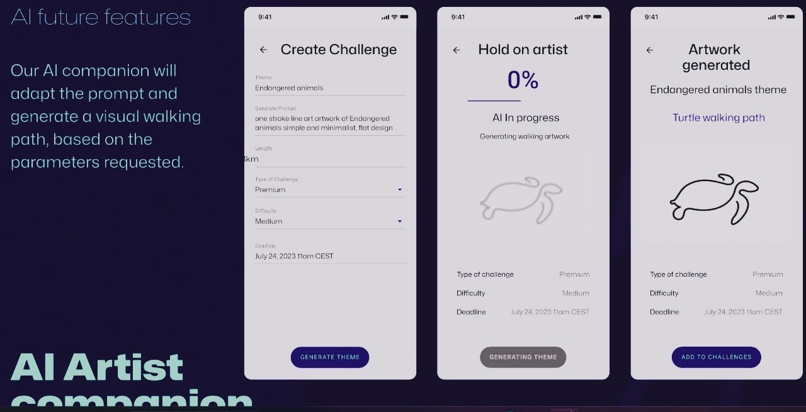

Slide 24
Additional Features:
We will be launching an exclusive 'PREMIUM' feature that not only enhances the token acquisition rate but also unlocks a wide array of additional benefits for our valued customers. Premium subscribers get early access to new features and updates, keeping them at the forefront of the platform's developments.
Develop virtual reality (VR) galleries for users. They can explore art collections in a 3D virtual space, providing an immersive art experience.
Provide members with a more dedicated support channel for faster assistance and issue resolution related to both fitness and reward aspects of the app.
Integrate our application into cutting-edge smartwatches and leverage the latest wearable technology to provide users with real-time fitness tracking, allowing them to seamlessly monitor their progress while enjoying the artistic rewards of their physical activities.

Slide 25

-Utkarsh Singh
-K.Sai Hemanth
-Omisha Singal
-Santhana Lakshmi
By

Slide 26
